Slide 1

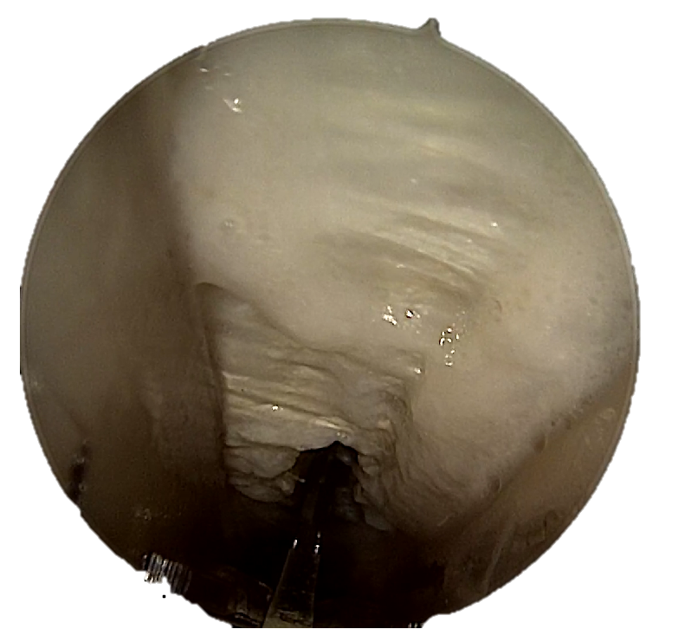
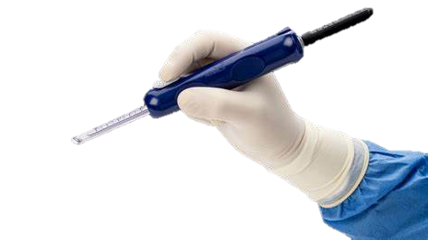

Cirugía Endoscópica del STC
Eduardo Vaquero Cervino
Servicio de COT - Unidad de Mano
Hospital de VIGO
Notes:
1 billon americano mil millones 1000.000.0001 billon europeo un millón de millones 1.000.000.000.000

Slide 2
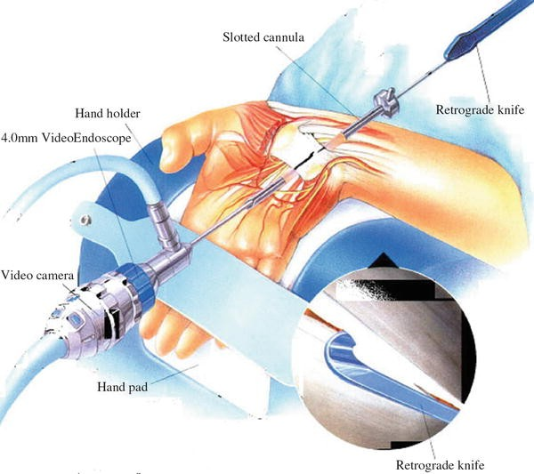
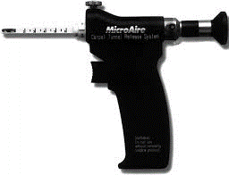
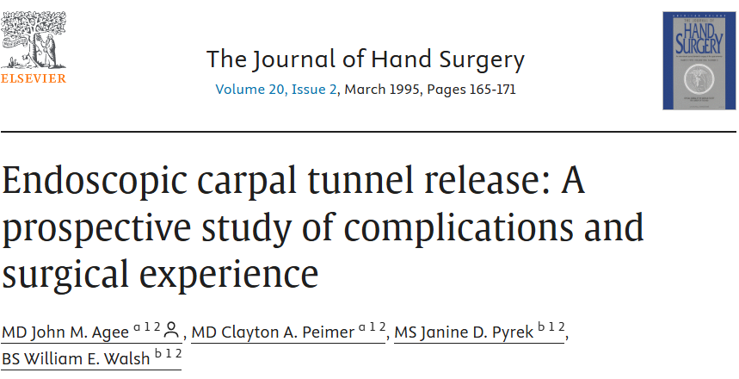
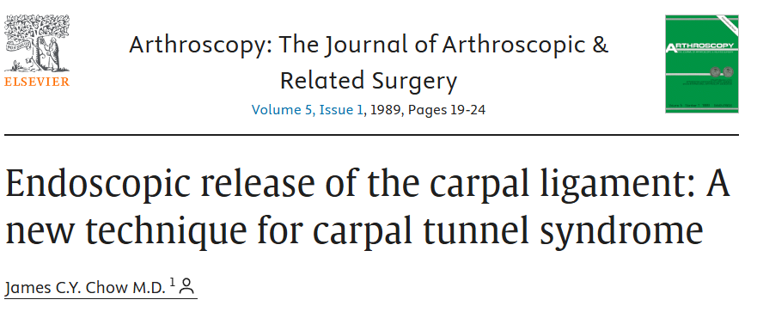
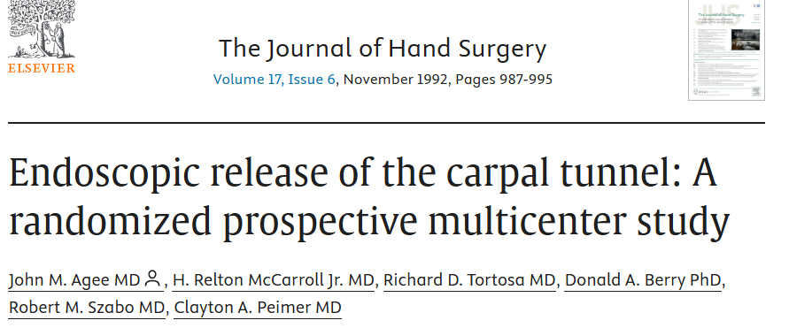
Introducción
1989
1992
Notes:
Chow 89
This is a preliminary report outlining an endoscopic technique to release the carpal ligament employing current arthroscopic methods. The technique has been used successfully on 62 hands in 46 patients with no known complications. In some cases, the follow-up period has been rather short. Based on our results, however, there has been rapid recovery with decreased scarring and postoperative pain and no loss of grip or pinch strength, which is sometimes seen with the conventional method of carpal ligament release.
Agee 92
A 10-center randomized prospective multicenter study of endoscopic release of the carpal tunnel was carried out. Surgery was performed with a new device for transecting the transverse carpal ligament while control hands were treated with conventional open surgery. There were 122 patients in the study; 25 had carpal tunnel surgery on both hands and 97 had surgery on one hand. Of the surgical procedures, 65 were in the control group and 82 were in the device group. The endoscopic device was coupled to a fiberoptic light and a video camera. A trigger-activated blade was used to incise the transverse carpal ligament. After surgery, the best predictors of return to work and to activities of daily living were strength and tenderness variables. For patients in the device group with one affected hand, the median time for return to work was 21½ days less than that for the control group. Two patients treated with the endoscopic device required reoperation by open surgical decompression; only one of these had incomplete release with the device. Two patients in the device group experienced transient ulnar neurapraxia.
Agee 95
63-center prospective study of endoscopic carpal tunnel release using the Agee Carpal Tunnel Release 1049 procedures in 988 patients. Prior experience with endoscopic release varied significantly among surgeon participants. Surgeons evaluated the newly redesigned system for blade visibility, blade height, and mechanical function. Data on patient complications were collected at the time of surgery and 3-4 weeks postoperative. The results indicated minimal complications and no confirmed injuries to vessels or nerves; the symptoms from one possible digital nerve injury eventually resolved completely. Surgeons were able to observe the point of entry of the blade into the transverse carpal ligament in 97.5% of procedures. Introduction of the blade assembly into the carpal tunnel was rated easy or adequate in 90.6% of procedures, and blade height was rated adequate in 97.4% of procedures.

Slide 3
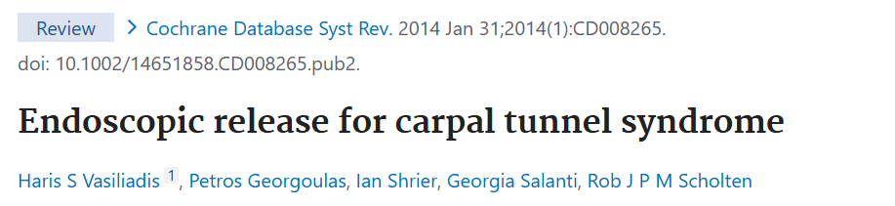
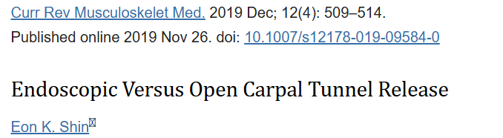

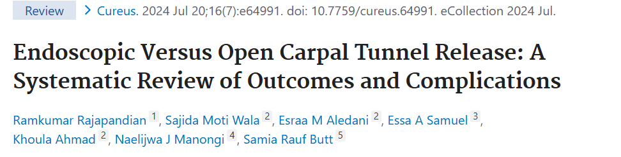
Proposal
Literature supports EARLY RECOVERY
with ENDOSCOPIC CTR

Slide 4


Proposal
Average Spanish salary
- 26.948,87 €/year
- 73,8€/day
Endoscopic device (centerline) = 380€
If we recover the patients faster
woud be cost efective
Notes:
INEbase / Mercado laboral /Salarios y costes laborales /Encuestas de estructura salarial / Últimos datos

Slide 5
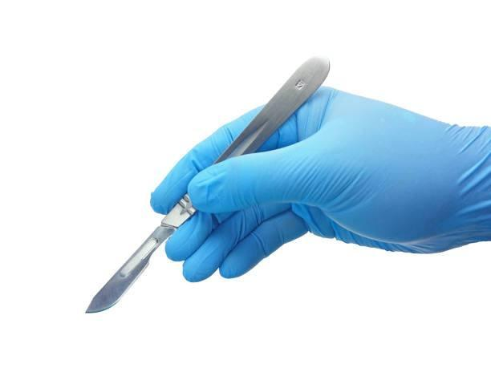

Material and methods
Retrospective study 2022 and 2024
41 CTS clinical + EMG diagnostic + Fail conservative treatment
22 Endoscopic
18 Open
Descriptive study: Age, gender, hand, type job
Objective: compare days on leave open vs endoscopic

Slide 6
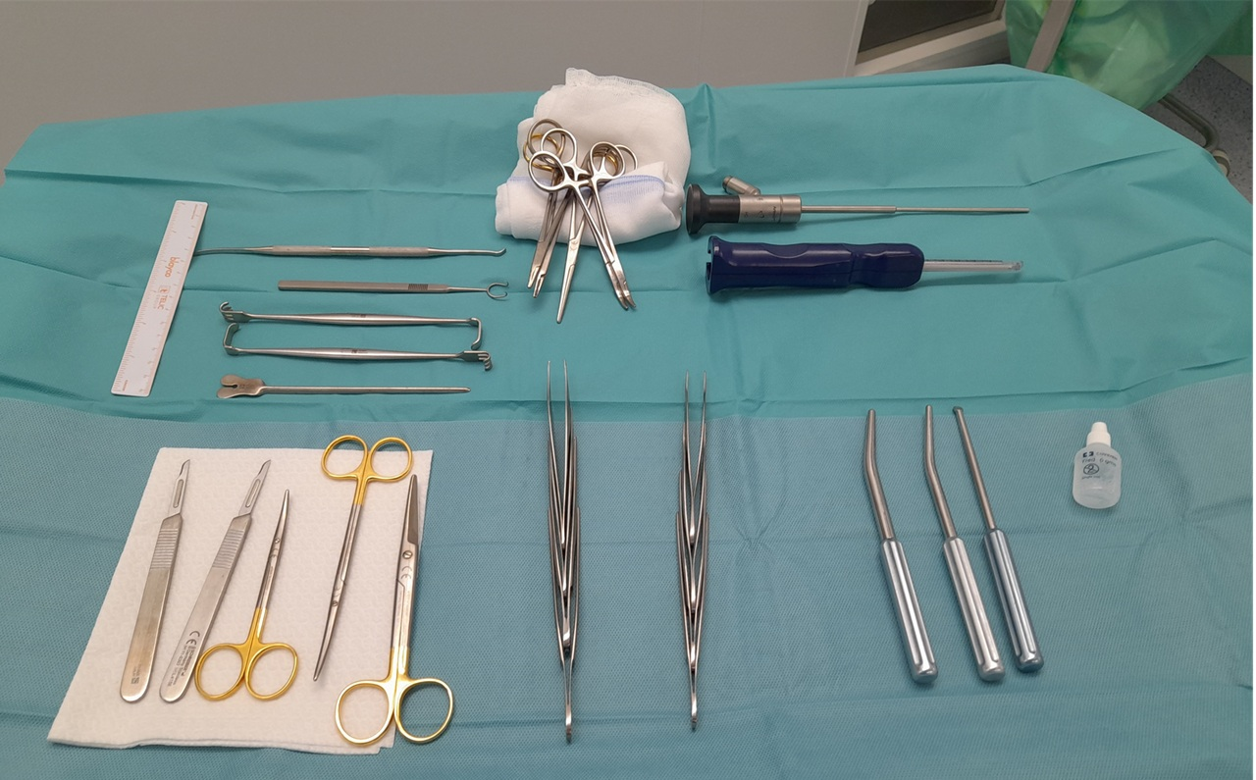
Técnica quirúrgica –Material Centerline

Slide 7
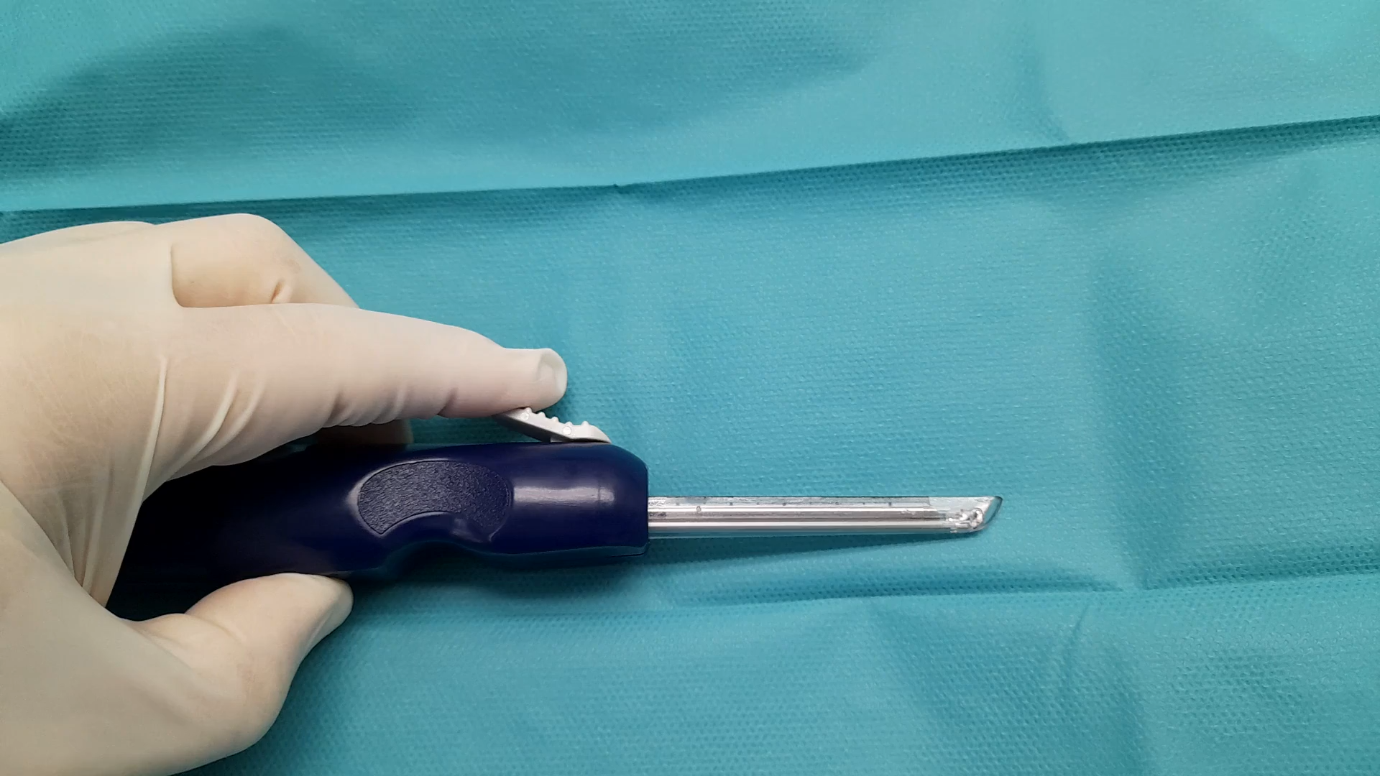
Técnica quirúrgica– Centerline

Slide 8
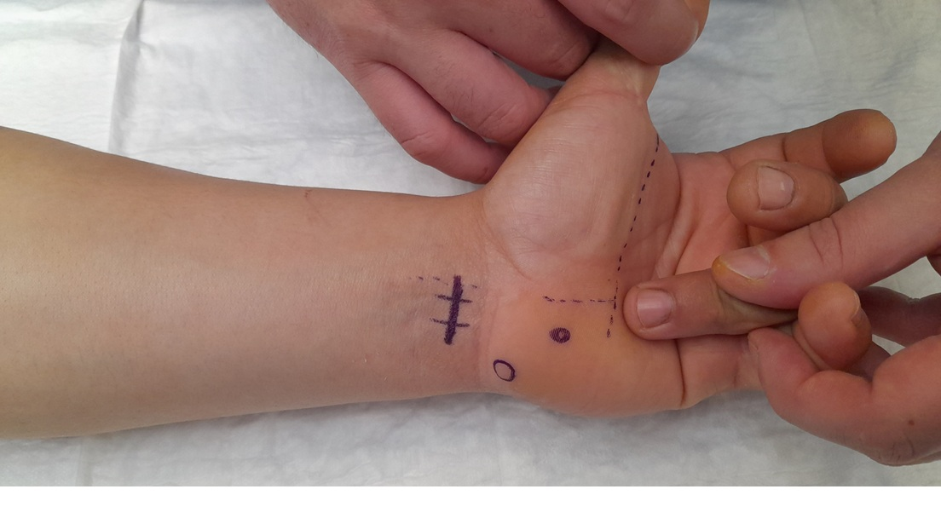
Técnica quirúrgica – Referencias Anatómicas

Slide 9
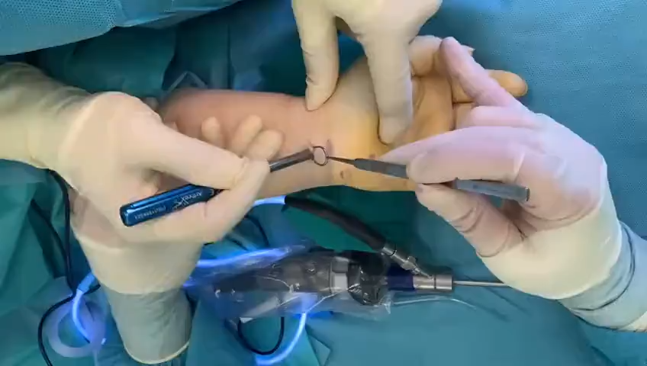
Técnica Quirúrgica

Slide 10
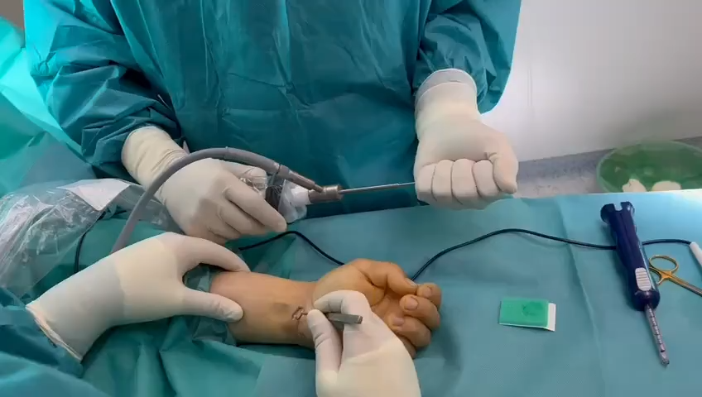
Técnica Quirúrgica

Slide 11
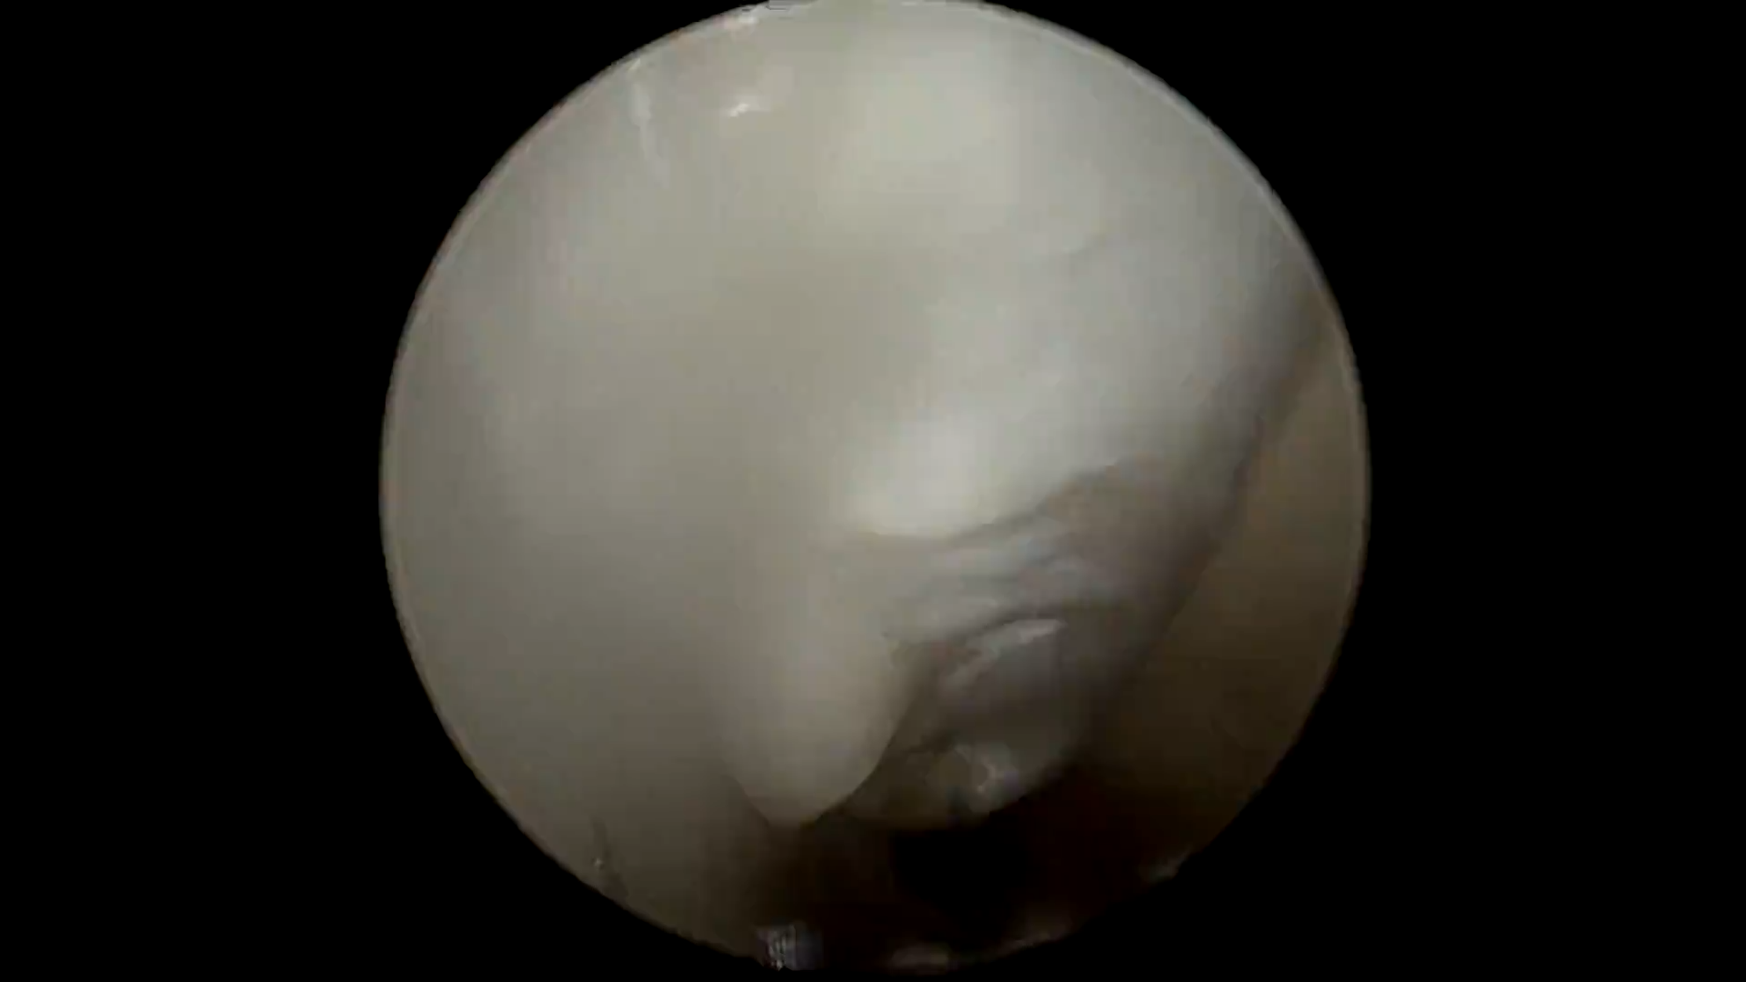
Técnica Quirúrgica -Vídeo

Slide 12
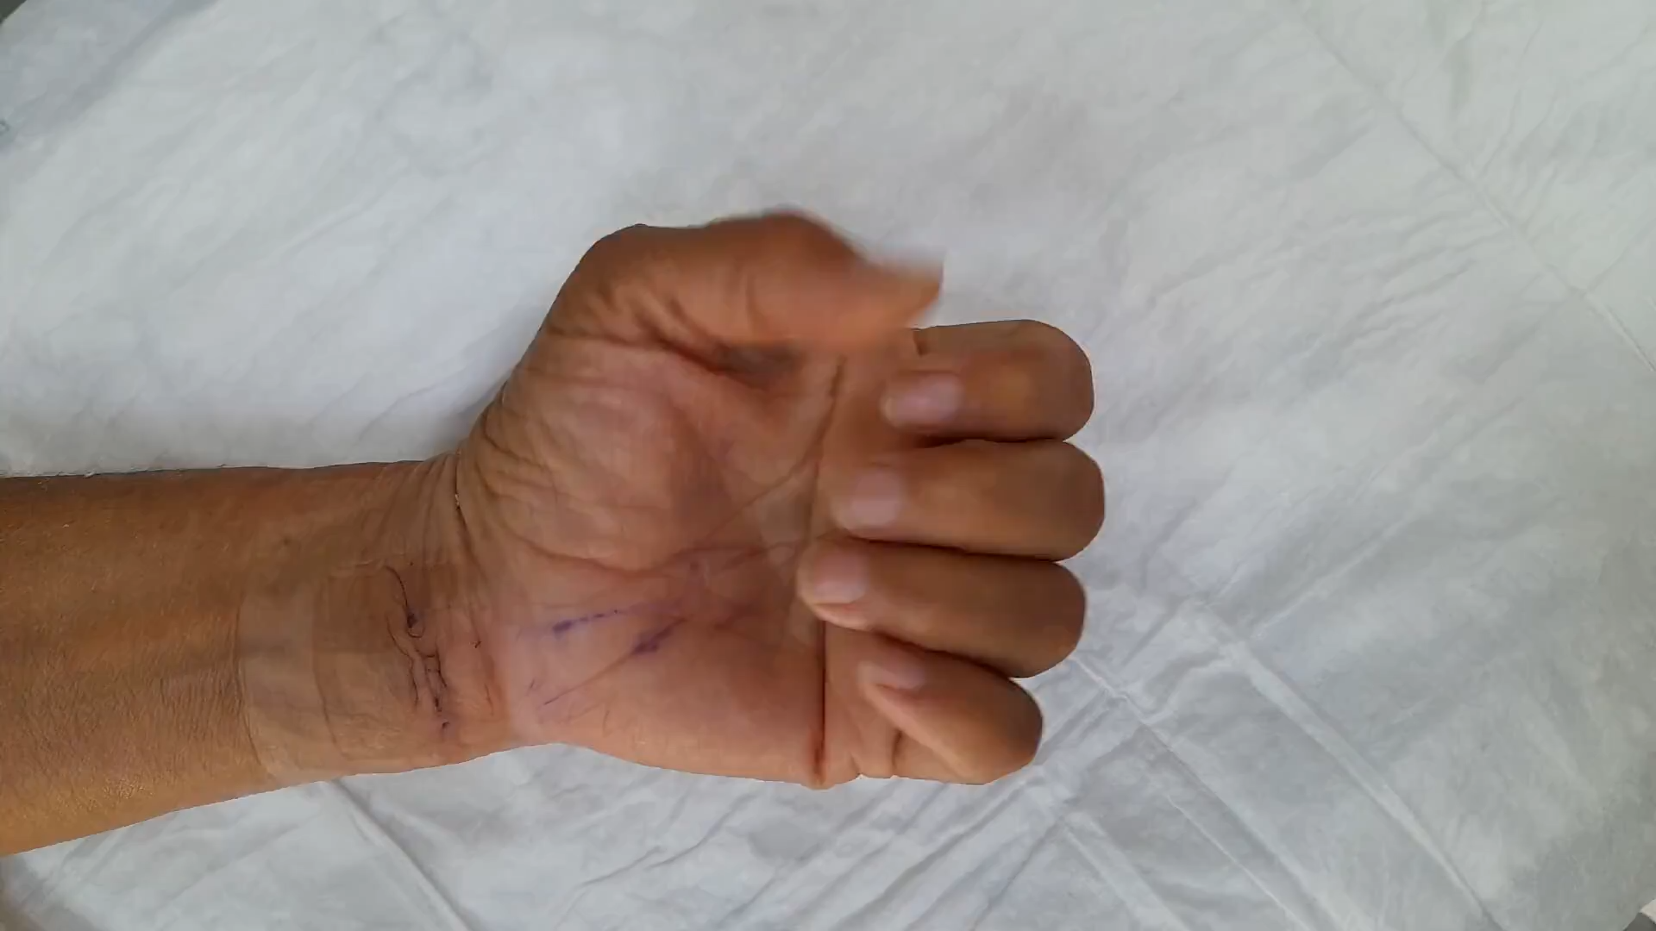
Post OP, 12 días

Slide 13






Resultados
49.25 mean age
41 CTS release
120.5 days on leave OPEN CTR
116 days on leave ENDOSCOPIC CTR
25 women
16 men
28 right
13 left
100% hard work
4.5 days favor ENDO
for recovery
Notes:
4.5 x 73.8 332,1
En promedio diría que algo menos… (4,53 días) pero según el test de Mann-Whitney/Wilcoxon aplicado a los datos de la muestra, las diferencias NO son estadísticamente significativas (ha podido ser por el azar)

Slide 14

Material y Métodos
Retrospectivo 2022 a 2024
41 STC clínicos + EMG + fracaso tto cosnervador
22 Endo
18 Abiertos
Descriptivo: Edad Sexo, lado, tipo de trabajo
Objetivo: comparar los días de baja ENDO y ABIERTO

Slide 15
Resultados
41 STC
19 Abierto
22 ENDO
25 mujeres
16 hombres
28 Dcho
13 Izq
100% trabajadores
de fuerza
Media 49.25 años
Notes:
4.5 x 73.8 332,1
En promedio diría que algo menos… (4,53 días) pero según el test de Mann-Whitney/Wilcoxon aplicado a los datos de la muestra, las diferencias NO son estadísticamente significativas (ha podido ser por el azar)

Slide 16

Resultados
Días de baja
Abierto 120,5
ENDO 116
4.5 días favor ENDO
Notes:
4.5 x 73.8 332,1
En promedio diría que algo menos… (4,53 días) pero según el test de Mann-Whitney/Wilcoxon aplicado a los datos de la muestra, las diferencias NO son estadísticamente significativas (ha podido ser por el azar)
Rew de 19 SHIN dice que Cochrane 2007 6 días a favor Guides AOOS2008 favor de endo
Estudio randomizado 8 días favor de endo Saw NL, Early outcome and cost-effectiveness of endoscopic versus open carpal tunnel release: a randomized prospective trial. J Hand Surg Br. 2003

Slide 17

Discussion
Endoscópico STC
4,5 días menos de baja
- Mismo coste
- Necesita equipamiento y aprendizaje
- Posiblemente mejor postoperatorio

Slide 18
Conclusion
ENDO STC
4.5 días
Menos de baja
+/- mismo costo
Pero…
Muestra pequeña
Retrospectivo
Necesita equipo y formación
Curva de aprendizaje

Slide 19

Gracias
Punta Robaleira Ría de Vigo

